Slide 1

Maine’s Solid Waste
Diversion Grant Program
Mark King
Organics Management Specialist
Division of Materials Management
MAINE DEPARTMENT OF ENVIRONMENTAL PROTECTION
Protecting Maine’s Air, Land and Water

Slide 2
Background
§2201-B. Maine Solid Waste Diversion Grant Program
Established to help to increase the diversion of solid waste from disposal in the State
Awards must be aligned with:
§2101. Solid waste management hierarchy
§2101-B. Food recovery hierarchy
Awards are prioritized based on maximum benefit in terms of increasing the diversion of solid waste from disposal
Department’s grant webpage:
Waste Diversion Grant Program

Slide 3
General Provisions-Notable Items
From the time the RFP is issued until award notification is made, all contact with the State regarding the RFP must be made through the RFP Coordinator (Mark King)…Violation of this provision may lead to disqualification from the bidding process, at the State’s discretion.
All proposals must adhere to the instructions and format requirements outlined in the RFP and all written supplements and amendments (such as the Summary of Questions and Answers), issued by the Department. Please read entire RFP.
In cases where there is more than one bidder per proposal, both parties must be listed as “co-applicants”. If an award is made on a joint proposal, one party will be designated as the “awardee”, and they will be the legal signature on any Department Contract.

Slide 4
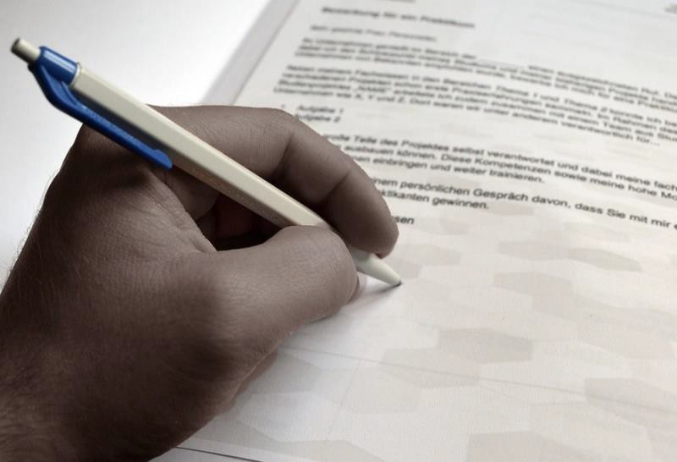

Who is Eligible to Apply?
Any public or private entity residing within the State of Maine
Must be able to demonstrate that a proposed program, project, initiative or activity is likely to increase the diversion of solid waste from disposal within a particular community, municipality or region of the State
Examples: private citizens, solid waste facilities, private businesses or nonprofits, schools, municipalities, institutions of higher learning, etc.
MAINE DEPARTMENT OF ENVIRONMENTAL PROTECTION
www.maine.gov/dep

Slide 5
Eligibility Restriction
Any entity requiring State or local licensure must have all license requirements met prior to proposal submission.
Any facility that currently holds a license through the Department or other authority must be in substantial compliance with said license and be up to date with all reporting requirements and associated fees.
Any entity applying for a grant must follow all State environmental laws, rules, and reporting requirements.
Proposed projects must follow all federal, state and local statutes, rules and regulations, including, but not limited to zoning, labor and transportation laws.

Slide 6
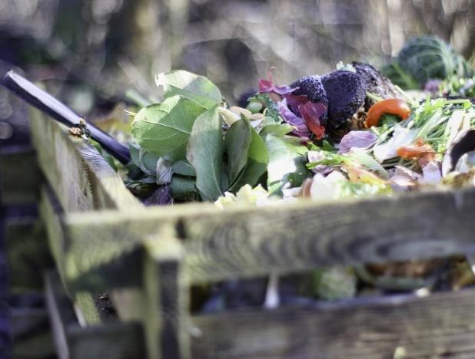
Examples of Eligible Activities
Establish/expand programs - composting, recycling, organics collection, food rescue, waste reduction (reuse, repair, etc.).
Equipment or supplies needed to implement, improve or support waste diversion activities.
Programs or business models designed to collect, transport for processing or process organic or recyclable materials.
Pilot programs to evaluate the feasibility of
new programs or initiatives.
Education and outreach initiatives or programs about composting, recycling, organics recovery repair clinics, or other sustainable practices to reduce solid waste.
MAINE DEPARTMENT OF ENVIRONMENTAL PROTECTION
www.maine.gov/dep

Slide 7

What is Prioritized?
Highest priority: Proposals from municipal or regional association applicants.
Increasing removal and recycling of solid waste from municipal waste streams
Other priorities include:
Underserved areas
Waste prevention: food donation, gleaning, reuse, repair, lending libraries, etc.
Education and outreach
Addressing a statewide need
Reducing greenhouse gas emissions
Expanding the type of materials recovered
MAINE DEPARTMENT OF ENVIRONMENTAL PROTECTION
www.maine.gov/dep

Slide 8
What Activities are NOT Eligible?
Proposals requiring passage of legislation to implement.
Projects or programs that have already been undertaken are not eligible for grant awards, unless the proposal includes significant changes/alterations that address any of the statutory criteria.
Administrative and indirect costs (benefits, overhead costs, etc.).
Project staff salaries (exception Student interns)
Any ongoing funding for positions after project inception will be the responsibility of the grantee.
All costs related to disposal.
MAINE DEPARTMENT OF ENVIRONMENTAL PROTECTION
www.maine.gov/dep

Slide 9
How to Apply
State of Maine Office of State Procurement Services has initiated a new process in which applicants must register with the State’s Vendor Self-Service System before they can access the current WDG RFP.
The following video explains the registration process: Registering in VSS. Once you have registered, the next steps are described in this video: Responding to RFP Solicitations in VSS.

Slide 10

Can I Ask Questions During the RFP?
Only through the proper channel, which is NOT an email or
phone call to Department staff including the RFP Coordinator
– Department staff including the RFP Coordinator may not answer
questions or otherwise discuss the RFP during the open RFP
Questions MUST be submitted in writing
following all instructions in the RFP and submitted through the “Vendor Self-Service System”.

Slide 11
Making an Application Stand Out
Think beyond your organization or immediate community
Consider project reach – will multiple communities or a large
geographic area be served?
Is the target area underserved, and will your project make a real and substantial difference?
Is your project unique, and if so, what about it is different?
Is this project likely to reduce greenhouse gas emissions, and if so, will you be able to estimate the emissions impact of the project?
Does the proposal push materials up the waste hierarchies?
– For example, food donation, gleaning, reuse, repair, lending programs (tool libraries, etc.) and other sharing initiatives preserve existing resources.

Slide 12

Common Pitfalls
Math: double-check your match, your cost totals, etc.
Pay attention to deadlines; for questions and for the completed application.
Make sure you submit all required documents and that each document is complete and accurate.
Ask questions through the appropriate channel and on time.
Read RFP carefully and follow all instructions to submit the application and questions via email.

Slide 13
A Final Word on Match…
All proposals providing “financial” match must include proof of available funds, as an addendum, at the time of submission of a proposal to the Department. Proof may include any of the following:
A recent bank statement,
Notice of intent to fund by an entity other than the applicant” or similar?, or
Any communication verifying available funds on bank letterhead.
In no case may Waste Diversion Funds be used as collateral to secure loans or leveraged to help secure other funding sources.

Slide 14
Questions?
Mark A. King
Organics Management Specialist
Mark.a.king@maine.gov
(207) 592-0455

